Slide 1
HACKFORGE

Slide 2
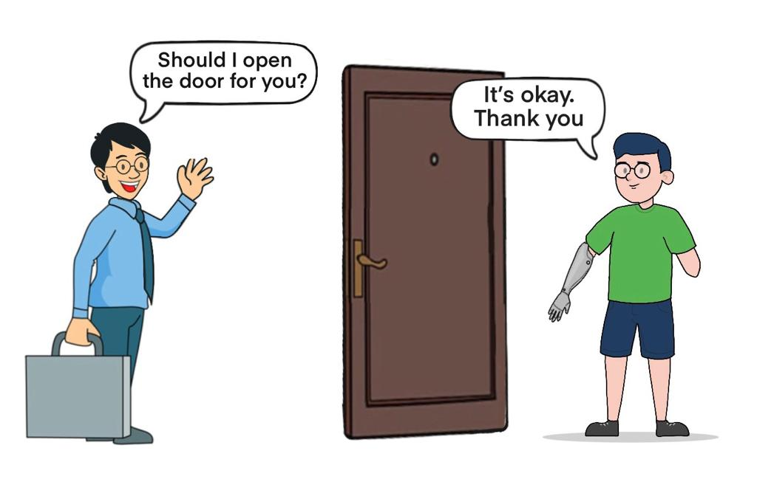
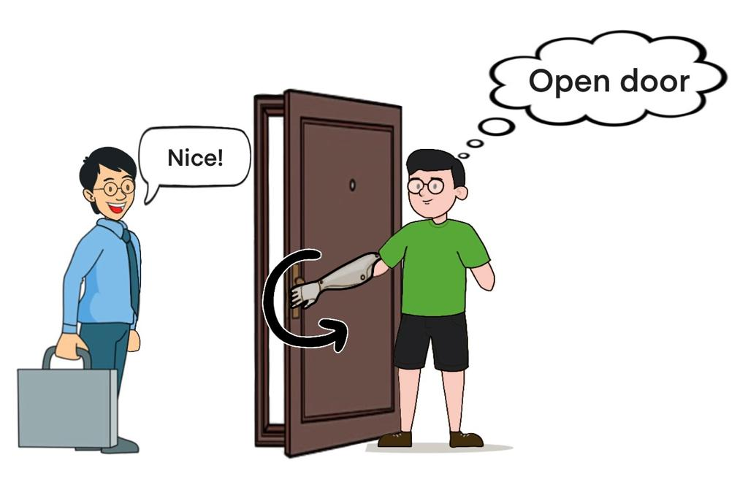
Notes:
"What if technology could help people with lost limbs move again, just by thinking about it?
We're a team working on making this real with our project, 'Mind-Machine Harmony.’”

Slide 3
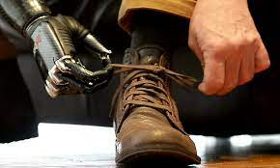
Problem Statement
Difficulty in Daily Tasks: "Users of prosthetic hands face challenges in performing simple, everyday tasks."
Lack of Natural Movement: "Current prosthetics do not move naturally, making them hard to use and limiting what users can do."
High Learning Curve: "Learning to use traditional prosthetic hands can take a long time, requiring effort and sometimes leading to frustration."
Goal: "Our aim is to create a solution that is easy to use and feels more like a natural part of the user."
Notes:
"Many people find it hard to use their prosthetic hands for everyday tasks. We wanted to make something easier and more natural for them."

Slide 4
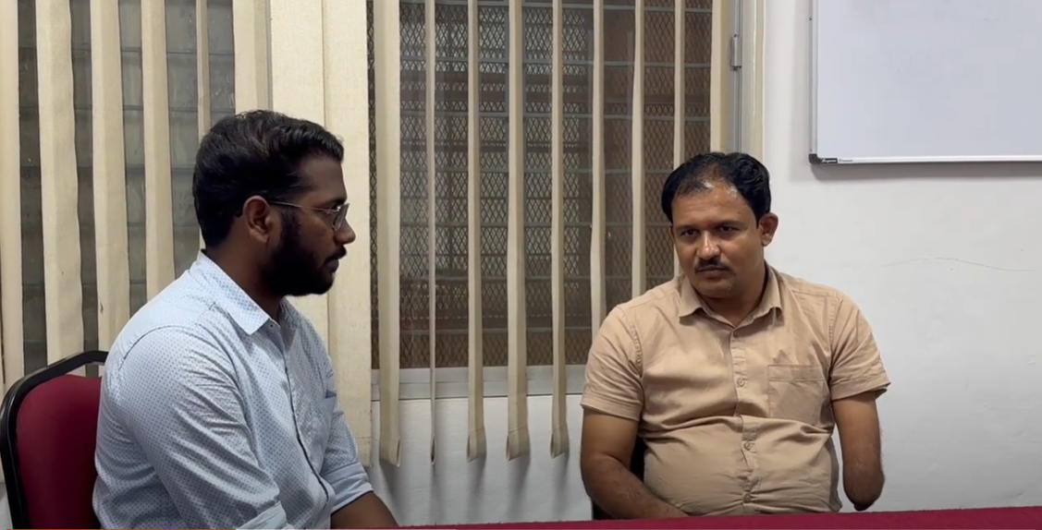
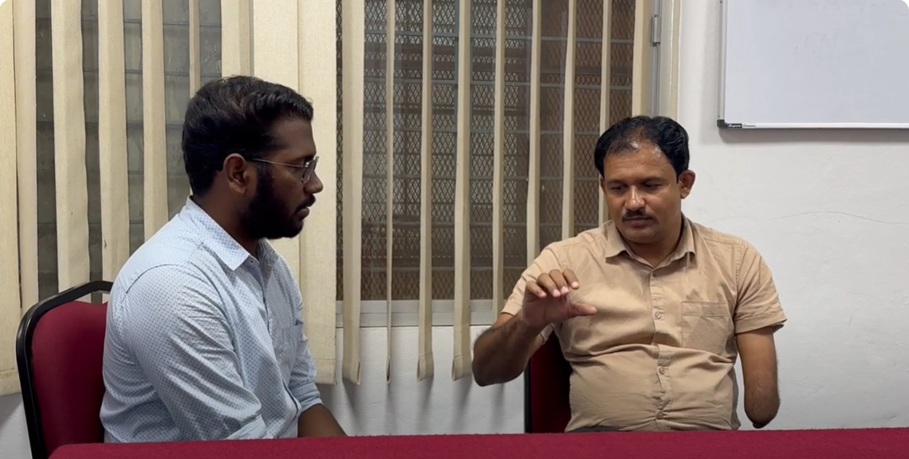
Customer Discovery and Insights
"They told us they want a hand that moves easily, just like a real one."
Notes:
"We talked to over 10 people who use prosthetic hands. We learned a lot about what they need and what problems they have."

Slide 5
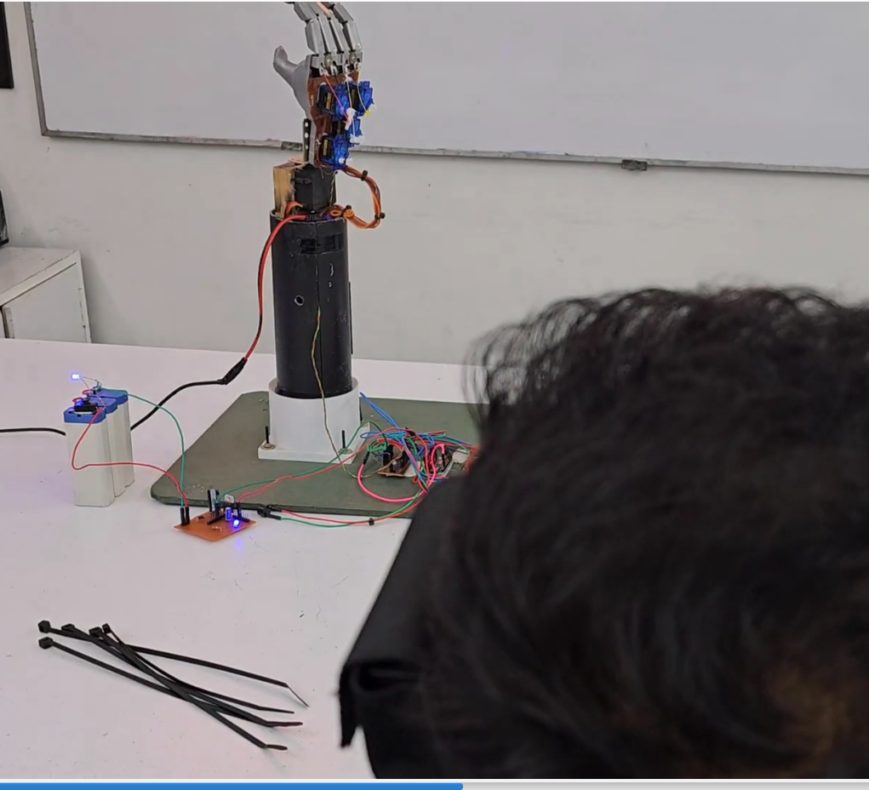
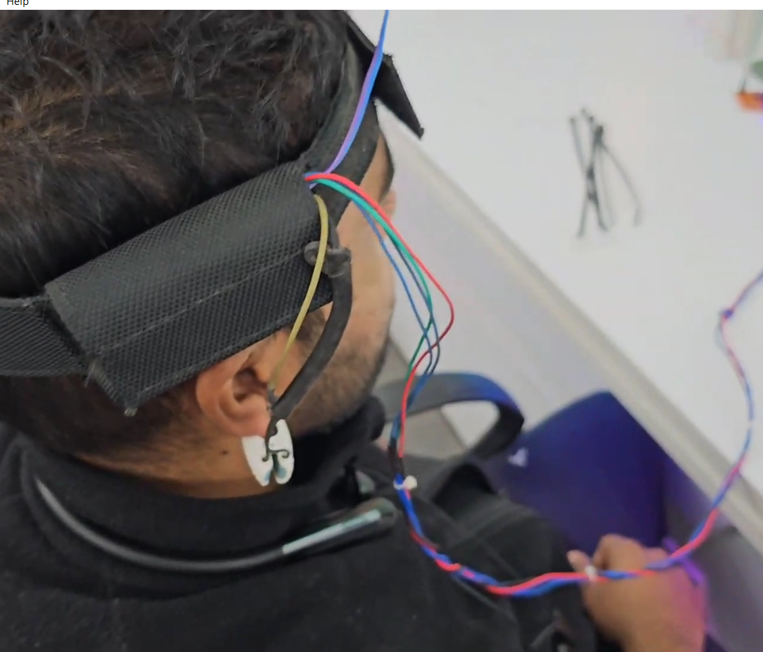
Our Solution: Mind-Machine Harmony
Notes:
"So, we made 'Mind-Machine Harmony.' It's a prosthetic hand that you can control with your thoughts, using a special headband that reads brainwaves."

Slide 6
A Revolutionary Prosthetic Hand
Controlled by Your Thoughts
Seamless Integration
Advanced Technology
Notes:
"Controlled by Your Thoughts: Utilizes a special headband to read brainwaves."
"Seamless Integration: Designed to feel natural and intuitive for the user."
"Advanced Technology: Incorporates the latest in EEG and machine learning for precise control."

Slide 7
How Mind-Machine Harmony Works
Thought
EEG Headband
Signal Processing
Prosthetic Hand Movement
Thought Recognition
Signal Processing
Precise Movement
Notes:
Thought Recognition: Captures the user's intention through EEG signals."
Signal Processing: Translates brainwaves into specific commands using advanced algorithms."
Precise Movement: Executes the desired hand movements smoothly and accurately."

Slide 8
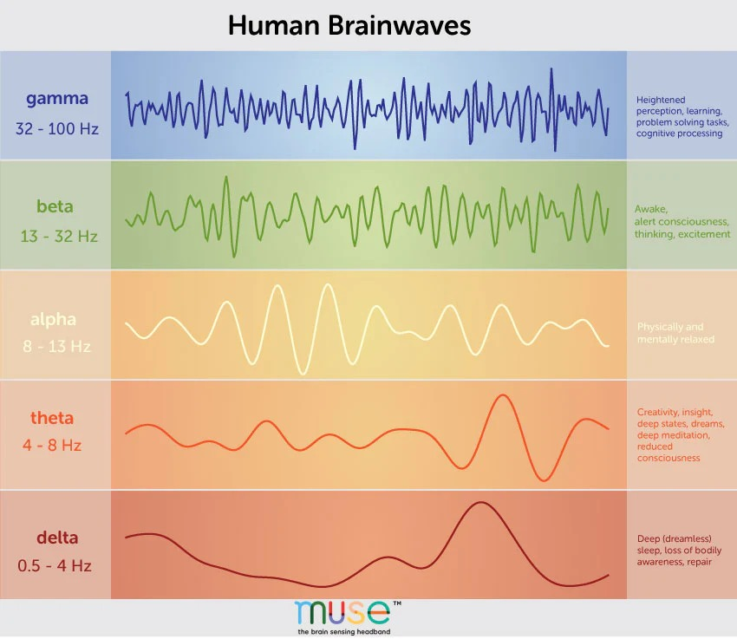

Slide 9
Unique Value Proposition
Heat Sensor Recognition
Direct Brain-to-Hand Interface
Natural User Experience
Scalable and Adaptable Technology
A Commitment to Inclusivity

Slide 10
MILESTONES
Advanced Brain-Computer Interface (BCI)
Improved User Experience
Extended Battery Life
Integration with Smart Devices

Slide 11
Final Product

Slide 12
Thank You !

